Slide 1
Cycles in discrete fractional
(with power-law memory) systems
Mark Edelman
Stern College for Women, Yeshiva University
Courant Institute of Mathematical Sciences, NYU
BCC CUNY
April 16, 2020

Slide 2
Study of nonlinear dynamics begins with a definition of periodic/fixed points and bifurcation diagrams.
In regular dynamics the skeleton of classical and quantum chaos is comprised of periodic orbits.
Fractional systems have no periodic solution (except the fixed points).
“How to find periodic sinks?” - this is the question.
This presentation follows the paper https://arxiv.org/pdf/2010.12924.pdf
 | arXiv:2010.12924

Slide 3



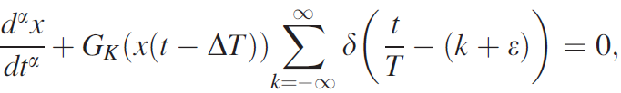
Fractional Universal Map; Key Words
Memory
Time delay
Periodically kicked system

Slide 4
Fractional Caputo Universal α-Families of Maps
Fractional Universal Map (order α), derived from a differential equation of a kicked system:

Slide 5
Fractional Difference Calculus
Fractional sum operator is a generalization of the n-fold sum operator
Proposed in Gray, H. and Zhang, N.F. (1988); proof can be found in Edelman, Discontinuity, Nonlinearity, and Complexity, 4 (2015). Falling factorial is defined as:
which is asymptotically power law:

Slide 6
Fractional Difference Calculus
Miller and Ross (1989) came to the same definition from the Green’s function approach and extended it to any real α
For α>0 fractional difference Caputo operator was introduced by Anastassiou (2009).
where Δ^{m}x(t) is the mth power of the forward difference operator Δx(t)=x(t+1)-x(t), . For the integer this definition converges to

Slide 7
Fractional Difference Caputo Universal
α-Family of Maps
Theorem. For , the Caputo like difference equation
where , with the initial conditions
is equivalent to the map with falling factorial-law memory
where x_{k} = x(k), which we will call the fractional difference Caputo Universal
α-Family of Maps.
Chen, Luo, X, and Zhou, (2011), Wu, Baleanu, and Zeng, S.D. (2014), Edelman, 2014
In the integer case, with x⁰_{n} = x_{n}, x^{s}_{n} =Δ x^{s−1}_{n−1},
s = 1, 2, ...,m −1 the map turns into the
m-dimensional volume preserving map

Slide 8
Fractional Difference Caputo Universal α-Families of Maps
Fractional Difference Universal Map, derived as a solution of a Caputo-like
fractional h-difference equation:
Falling factorial h-falling factorial

Slide 9
Common equation (0<α<1)
All maps can be written as
In this formula and x₀ is the initial condition.
In fractional maps:
And in fractional difference maps:

Slide 10

Upper: K = 15.5 (a) x₀=
0.29+.04i, i=0-8 (i=0 is the rightmost bifurcate-on); (b) x₀= 0.61+.06i, i=1-3; (c) x₀=0.95+.04i, i=1-3.
T=2: x_{lim1}=0.806, x_{lim2}=1.036; The unstable fixed point x_{lim0}=0.935.
Asymptotically period two trajectories for the Caputo fractional (upper) and
fractional difference (lower) logistic α-family of maps with α = 0.1
Lower: K = 2.5 (a) x₀=
10⁻⁴, 0.085+.005i (i=0-3), 0.12, 0.14 (the left-most); (b) x₀= 0.6+.1i, i=1-3; (c) x₀=0.9.
T=2: x_{lim1}=0.305, x_{lim2}= 0.724; The unstable fixed point x_{lim0}=0.6.

Slide 11
Convergence to the stable fixed point follows the power law with the power α
Power-law convergence of trajectories to the fixed point (stable (b) or unstable (a) and (c))
for the fractional (a) and (b) and fractional difference (c) Caputo logistic α-family of maps.

Slide 12
l-cycles
For n=Nl+m,
where 0<m<l+1:
l totals, each
includes only
lth points in a
cycle.
1 2 3 … l +0xl
1 2 3 … l +1xl
…………….
1 2 3… m-1 +Nxl

Slide 13
l-cycles
where S₀ is a sum of
A finite number of terms which tend to 0 as

Slide 14
l-cycles
Let’s assume that when the system converges to a period l sink (l-cycle):
then, as the previous equation can be written as
Here we have l
infinite totals,
which will be
considered on the
next slide.

Slide 15
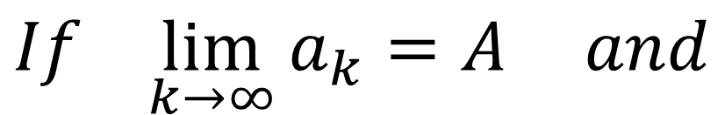
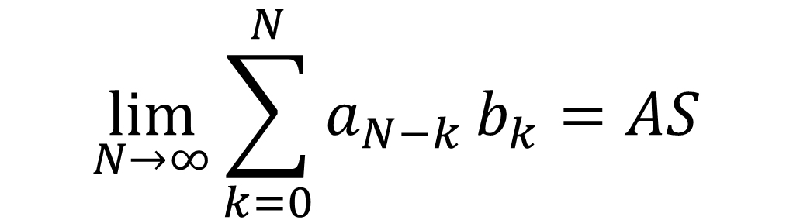

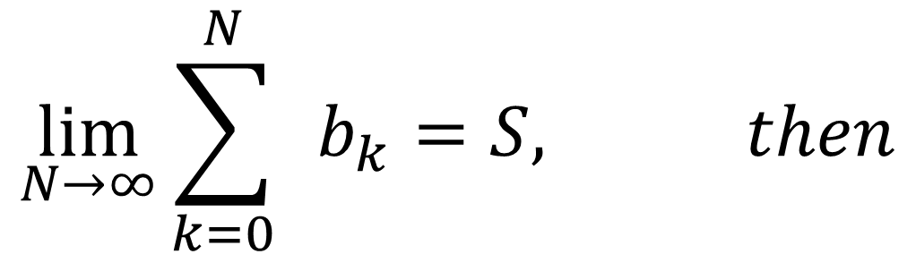
$$\lim_{N→∞}{\sum_{k=0}^{N}{ }}b_{k}=S, then$$
$$If \lim_{k→∞}{a_{k}=A} and$$
$$\lim_{N→∞}{\sum_{k=0}^{N}{a_{N−k}}}b_{k}=AS$$
$$Σ=$$
$$If S=∞,{then Σ is finite only if A=0. }$$

Slide 16
l-cycles
Only for j=0 the total starts at k=1.

Slide 17
l-cycles
It is strictly proven in the Arxiv paper, that for every ε there exists N_{l} and N_{d}, such that for any N₁> N_{l} and N-N₁> N_{d}, the difference between the sum on the previous slide and
is less then ε. Here converging sums S_{j} (each difference in the brackets is of the order (lk+j)^{α-2}) are
,
and ,

Slide 18
l-cycles
Finally, the system of l-1 equations to define n variables x_{lim,m} can be written as
and to close this system we consider
the limiting ( ) value of
the sum of all periodic points:

Slide 19
l-cycles
The terms in the fist and the last rows of the last equation are finite, which implies that the limiting value of the middle row
must also be finite.
It is shown in the Arxiv paper that the only case in which S is finite is:
This is the last equation that closes the system of equations to define cyclic points.

Slide 20
S_{i}-sums (fractional)
Just an example: S₁ calculations for l=3-cycle and fractional maps
where
and
In each term we factor out (3k)^{α-1} and develop the remaining difference into a Taylor series.

Slide 21
S_{i}-sums (fractional)
where

Slide 22
S_{i}-sums (fractional difference)
A fractional difference example: S₂ calculations for l=3-cycle:
and
use
(A. Laforgia and P. Natalini, J. Math. Anal. App. 389, 833 (2012))
with a=α and b=2. Then,

Slide 23
S_{i}-sums (fractional difference)

Slide 24
S values for period 3 cycles (fractional maps on the left and fractional difference on the right).

Slide 25
S values for period 2 cycles (fractional maps on the left and fractional difference on the right).

Slide 26
α-families of maps
Standard (α=2) - circle (α=1) - sine (α=0): G_{K}(x)=Ksin(x)
Logistic: G_{K}(x)=x-Kx(1-x)
T=2 - cycle in the case of the logistic families of maps (0<α<1):
Then,
Where K_{C1s}=Γ(α)/(S₂h^{α}) ( is the first bifurcation point of the standard families of maps and
defines the first bifurcation point.

Slide 27
  The first bifurcation point for the logistic map (h=1).

Slide 28
K=3.2 (stable T=2 point) K=3.3 (stable T=4 point) K=3.4 (chaos)
The Poincaré plots (500000 iterations) for fractional difference logistic map with α= 0.75 and x₀ = 0.3. Two asymptotically unstable T = 3 cycles, {0.116,0.533,0.887} and {0.0696,0.385,0.894}, are marked by the plus signs.

Slide 29
Fractal structure of chaotic Poincaré plots
Fractional difference
logistic map
K=3.4, α= 0.75, and x₀ = 0.3

Slide 30
Bifurcation Diagrams: Caputo Standard Families of Maps 0<α<1
Bifurcation diagrams for the fractional difference Caputo Standard αFM Eq. (a, c, and e) and the fractional Caputo Standard αFM (b, d, and f).
The diagrams were obtained after 5000 iterations with the initial condition x₀ = 0.1 (regular points) and x₀ = −0.1 (bold points).
α = 0.8 in a and b; α = 0.3 in c and d;
α = 0.01 in e and f.
Notes:
30

Slide 31
Bifurcation Diagrams: Caputo Standard Families of Maps 0<α<1
Bifurcation diagrams for the fractional and fractional difference Caputo Logistic αFM with α=0.8.
Notes:
31

Slide 32
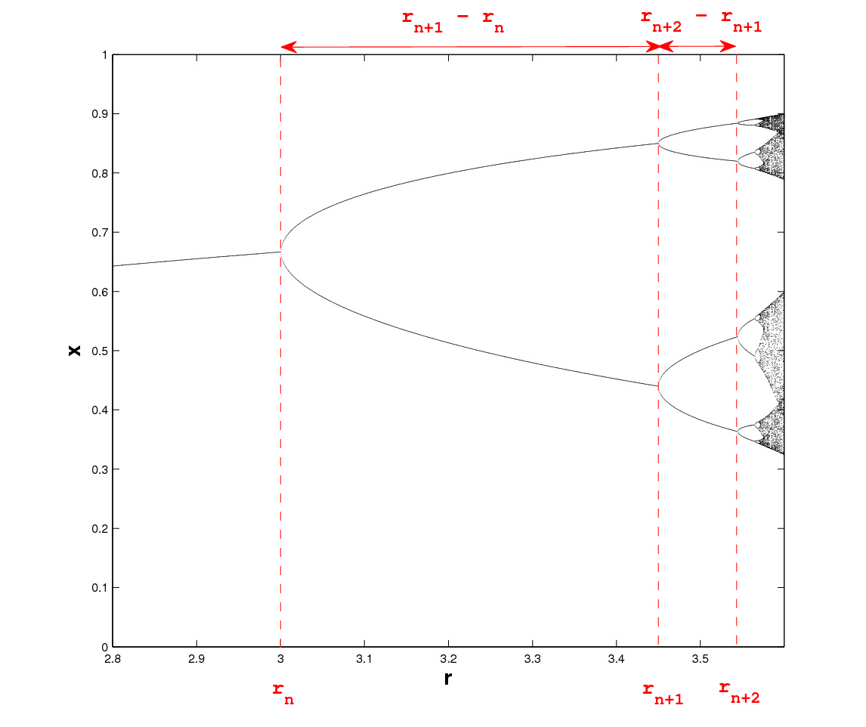
The universal period doubling route to chaos
At the point K =K_{n} a transition from complex to real solutions occurs and a stable real T = 2^{n}-cycle, which is nota T = 2^{n-1}-cycle, is born.
Conjecture: for fractional maps there is a universal limit, which may depend on a, similar to the Feigenbaum’s constant:

Slide 33
Conclusion
In this presentation we derived the equations which allow calculation of the asymptotically
periodic points for fractional and fractional difference maps.
This sets the framework to analyze bifurcations and chaos in discrete fractional systems:
Calculate the values of coefficients S_{i}.
Specify the value of h and the function G(x) for your map.
Use some methods (e.g., l-dimensional Newton method) to solve equations for l-cyclic points. Start with a known value for α=1 and proceed with small steps in α and K to find the critical values of parameters at which the bifurcations occur.
Place the values of unstable cyclic points on chaotic phase portraits or return maps (which look like chaotic attractors in the case of fractional/fractional difference maps) to analyze chaotic behavior of the maps.

