Slide 1
Discrete Time Markov Chains with Random Transition Times –Fractional Markov Chains
Entanglement of probabilities, Spectral gaps, Predictable and Unpredictable Information Components
Dimitri.Volchenkov@ttu.edu

Slide 2
Thanks Yuri!
“Green Measures for Time Changed Markov Processes” by José L. da Silva, Yuri Kondratiev
“Random Time Dynamical Systems I: General Structures” by José Luís da Silva, Yuri Kondratiev
“Green Measures for Markov Processes” by Yuri G. Kondratiev, José L. da Silva
“Random potentials for Markov processes” by Yuri G. Kondratiev, Yuliya Mishura, José L. da Silva
What might it look like in discrete time case?

Slide 3
Random Transition Time in Discrete Time Markov Chains
A discrete-time Markov chain is a sequence of random variables $X_{0},X_{1},X_{2},…$ taking values from a countable set with the Markov property, $\operatorname{Pr}\left(X_{n+1}=y | X_{n}=x\right)=T_{xy}>0$ , so that $\operatorname{Pr}\left(X_{n}=y | X_{0}=x\right)={\left(T^{n}\right)}_{xy}$
If the transition time is random, we make 1,2,3,.. – a random number of transitions per unit time. The expectation of a transition operator is
$$T_{ε}=\sum_{k=0}^{∞}{K\left(k;ε\right)T^{k}},K\left(k;ε\right)≥0,\sum_{k=0}^{∞}{K\left(k;ε\right)=1}$$

Slide 4
ARFIMA-type Kernel for a Fractional Markov Chain
The Autoregressive Fractional Integral Moving Average (ARFIMA) models, a fractional order signal processing technique generalizing the conventional integer order models— autoregressive integral moving average (ARIMA) and autoregressive moving average (ARMA) model.
The Grunwald-Letnikov fractional difference of order α with the unit step τ, and the time lag operator Τ
$∆_{τ}^{1−ε}x\left(t\right)={\left(1−T_{τ}\right)}^{1−ε}x\left(t\right)=\sum_{k=0}^{∞}{{\left(−1\right)}^{k}\left(\begin{matrix}1−ε \\ k\end{matrix}\right)x(t−kτ)}$
$${\left(1−T\right)}^{1−ε}=\sum_{k=0}^{∞}{\frac{Γ\left(k−1+ε\right)}{Γ\left(k+1\right)Γ\left(−1+ε\right)}T^{k}}=1+\sum_{k=1}^{∞}{\frac{Γ\left(k−1+ε\right)}{Γ\left(k+1\right)Γ\left(−1+ε\right)}T^{k}}≡1−T_{ε}$$
$$T_{ε}≡\sum_{k=1}^{∞}{\frac{−Γ\left(k−1+ε\right)}{Γ\left(k+1\right)Γ\left(−1+ε\right)}T^{k}}$$
Preserving the structure of Laplacian operator
$$1$$
$$K\left(k;ε\right)$$
$$…$$
$$∞$$
$$2$$
$$1$$
$$3$$
$$ε=1$$
$$ε=0$$
$$T_{ε→0}=T, transition moment is precise; T_{ε→1}⟼∆_{τ}^{1−ε}→{\left(1−T\right)}^{0} :random transition time\sim [1,∞)$$

Slide 5
Example: A biased coin with random flipping times
$$1−p$$
$$T\left(p,q\right)=\left(\begin{matrix}p & 1−p \\ 1−q & q\end{matrix}\right)$$
0
1
$$p$$
$$q$$
$$1−q$$
$$T_{ε}\left(p,q\right)=\sum_{k=1}^{∞}{\underset{K\left(k;ε\right)}{\underbrace{\frac{−Γ\left(k−1+ε\right)}{Γ\left(k+1\right)Γ\left(−1+ε\right)}}}T^{k}\left(p,q\right)}$$
$$1$$
$$K\left(k;ε\right)$$
$$…$$
$$∞$$
$$2$$
$$1$$
$$3$$
$$ε=0$$
$$ε=1$$
$$=\left(\begin{matrix}1−\frac{1−p}{{\left(2−p−q\right)}^{ε}} & \frac{1−p}{{\left(2−p−q\right)}^{ε}} \\ \frac{1−q}{{\left(2−p−q\right)}^{ε}} & 1−\frac{1−q}{{\left(2−p−q\right)}^{ε}}\end{matrix}\right)≡\left(\begin{matrix}p_{ε} & 1−p_{ε} \\ 1−q_{ε} & q_{ε}\end{matrix}\right)$$

Slide 6
Properties of $T_{ε}\left(p,q\right)$
$$T_{ε}\left(p,q\right)=\left(\begin{matrix}1−\frac{1−p}{{\left(2−p−q\right)}^{ε}} & \frac{1−p}{{\left(2−p−q\right)}^{ε}} \\ \frac{1−q}{{\left(2−p−q\right)}^{ε}} & 1−\frac{1−q}{{\left(2−p−q\right)}^{ε}}\end{matrix}\right)≡\left(\begin{matrix}p_{ε} & 1−p_{ε} \\ 1−q_{ε} & q_{ε}\end{matrix}\right)$$
$\lim_{ε→0}{p_{ε}}=p, \lim_{ε→0}{q_{ε}}=q,$ $\lim_{ε→1}{p_{ε}}= \frac{1−q}{2−p−q}=π_{1}, \lim_{ε→1}{q_{ε}}= \frac{1−p}{2−p−q}=π_{2}, πT=1∙π$
The state repetition probabilities $p_{ε}$ and $q_{ε}$ get entangled with one another due to the normalization factor ${\left(2−p−q\right)}^{−ε}$ in the transition probabilities
$πT=1 π$, $uT=λ_{2}\left(p,q\right)u$ $→$ $πT_{ε}=1 π$, $uT_{ε}=λ_{2}^{\left(ε\right)}\left(p,q\right)u,{ λ}_{2}^{\left(ε\right)}=1 −\frac{2−p−q}{{\left(2−p−q\right)}^{ε}}$
$$T_{1}\left(p,q\right)=\left(\begin{matrix}π_{1} & π_{2} \\ π_{1} & π_{2}\end{matrix}\right)$$

Slide 7
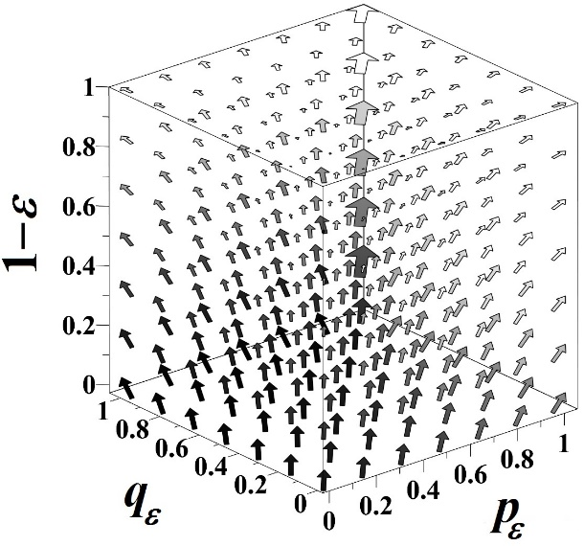
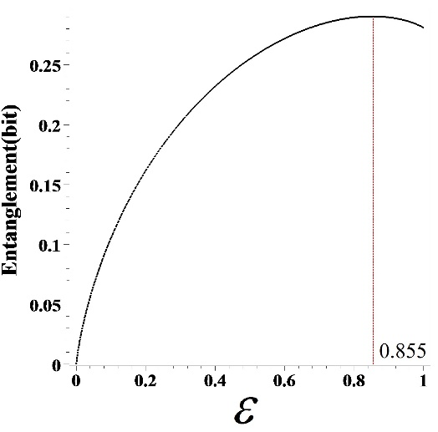
Entanglement of probabilities
The degree of entanglement between the transition probabilities $p_{ε}$ and $q_{ε}$ over $ε$ can be assessed by the expected divergence,
$Ent\left(ε\right)=\iint_{0}^{1}{dpdq\left(π_{1}\log_{2}{\frac{p}{p_{ε}}}+π_{2}\log_{2}{\frac{q}{q_{ε}}}\right)}=2\iint_{0}^{1}{dpdq\left(π_{1}\log_{2}{\frac{p}{p_{ε}}}\right)}$
The${\left(2−p−q\right)}^{−ε}$- flow over $1−ε$
The varying degree of entanglement between the probabilities $p_{ε}$ and $q_{ε}$ attains the maximum value at $ε=0.855$.

Slide 8
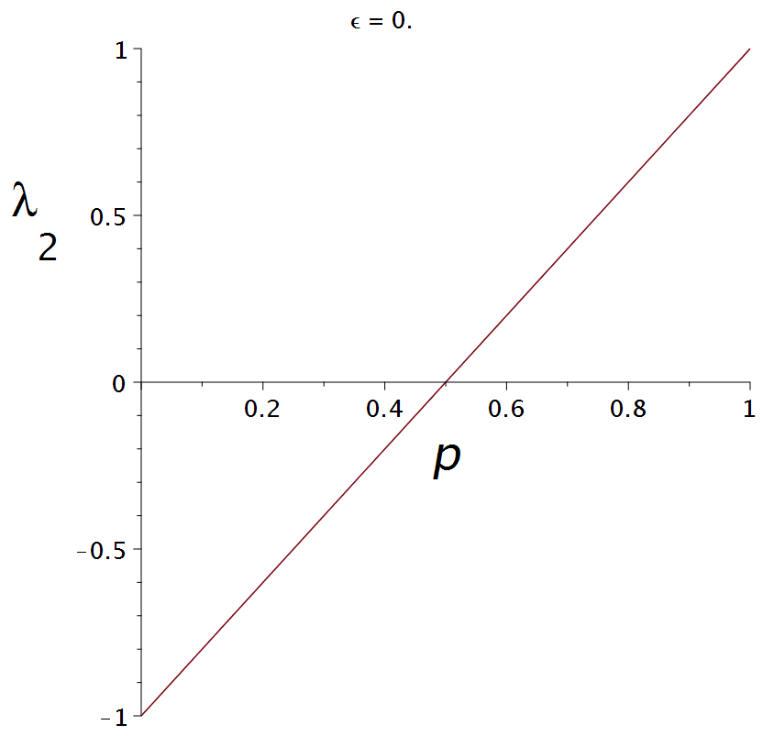
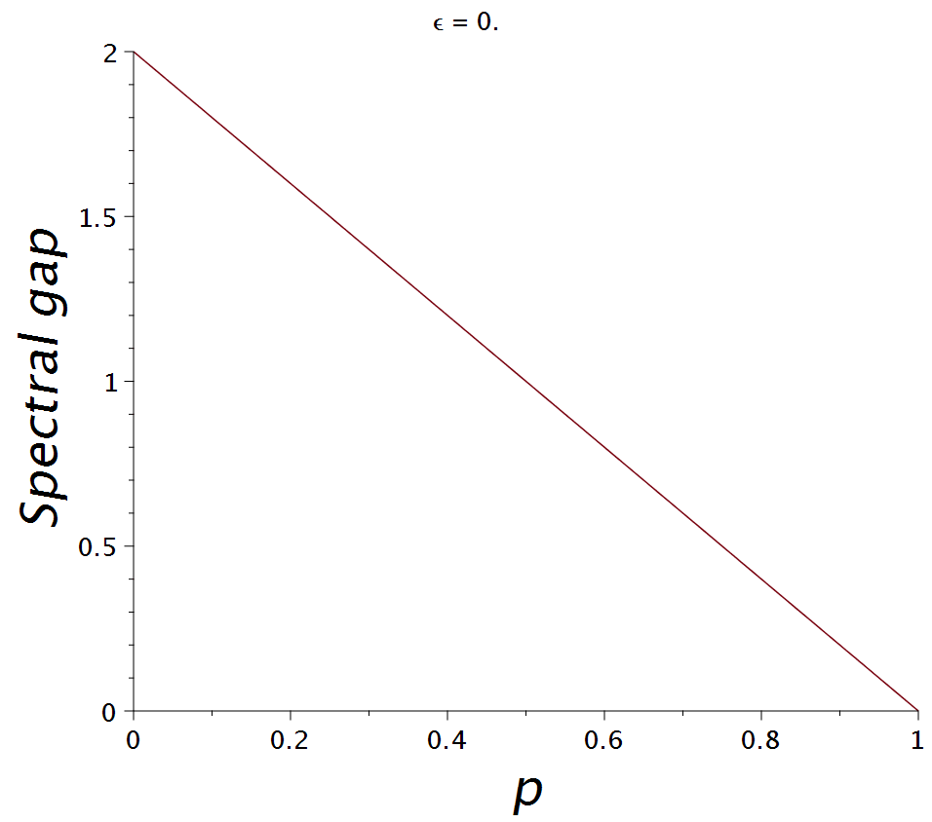
Spectral gap $1−λ_{2}^{\left(ε\right)}\left(p\right)$
$$1−p$$
$$p$$
0
1
$$p$$
$$1−p$$
$$ε→1$$

Slide 9
Predictable and Unpredictable Information Components
The entropy function expresses the amount of uncertainty (information) resolved by flipping a coin,
$$H\left(p,q\right)=P\left(p,q\right)+U\left(p,q\right),$$
where the predictable part $P\left(p,q\right)$ estimates the amount of apparent uncertainty about the future flipping outcome that might be resolved from the sequence of sides already shown, and the unpredictable information component $U\left(p,q\right)$ that cannot be inferred anyway.
$H\left(X_{t}\right)=H\left(X_{t}\right)±H\left(X_{t+1} | X_{t}\right)$ $±H\left(X_{t} | X_{t−1}\right)$ $±H\left(X_{t+1} | X_{t−1}\right)$
$$=\underset{E, \text{excess} \text{entropy}}{\underbrace{H\left(X_{t}\right)−H\left(X_{t+1} | X_{t}\right)}+}\underset{I\left(X_{t};X_{t+1} | X_{t−1}\right)}{\underbrace{H\left(X_{t+1} | X_{t−1}\right)−H\left(X_{t} | X_{t−1}\right)}}$$
$$+\underset{H\left(X_{t} | X_{t−1};X_{t+1}\right)}{\underbrace{H\left(X_{t+1} | X_{t}\right)+H\left(X_{t} | X_{t−1}\right)−H\left(X_{t+1} | X_{t−1}\right)}}$$
$$P$$
$$U$$

Slide 10
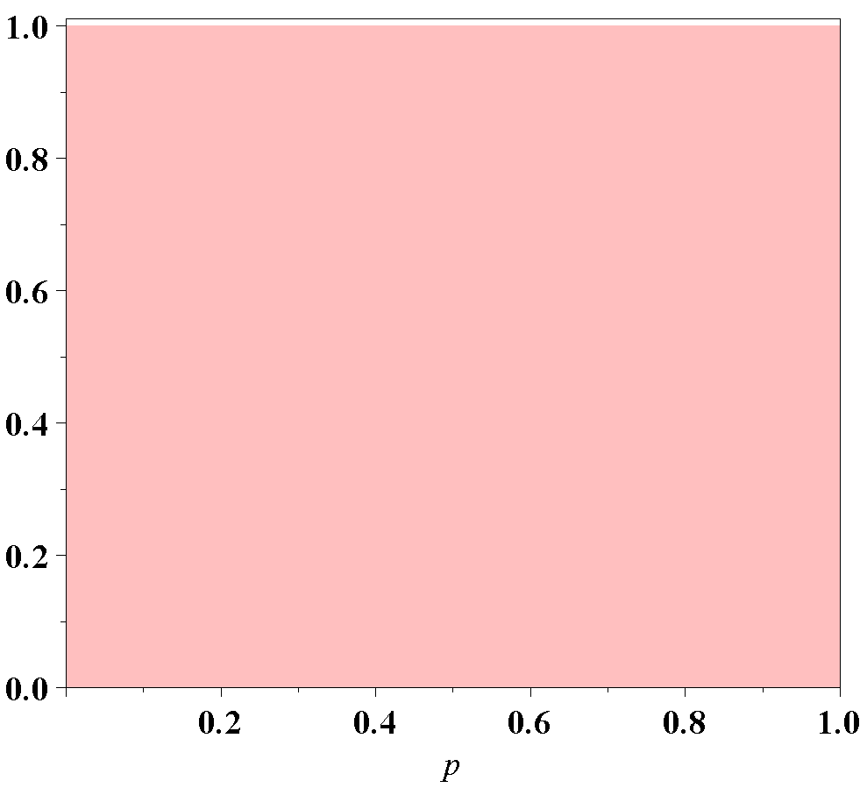
Tossing an unfair coin
$$H\left(X_{t}\right)$$
Entropy (bit)
Tossing an unfair coin to choose between two alternative states reveals a single bit of information, for any value of p.

Slide 11
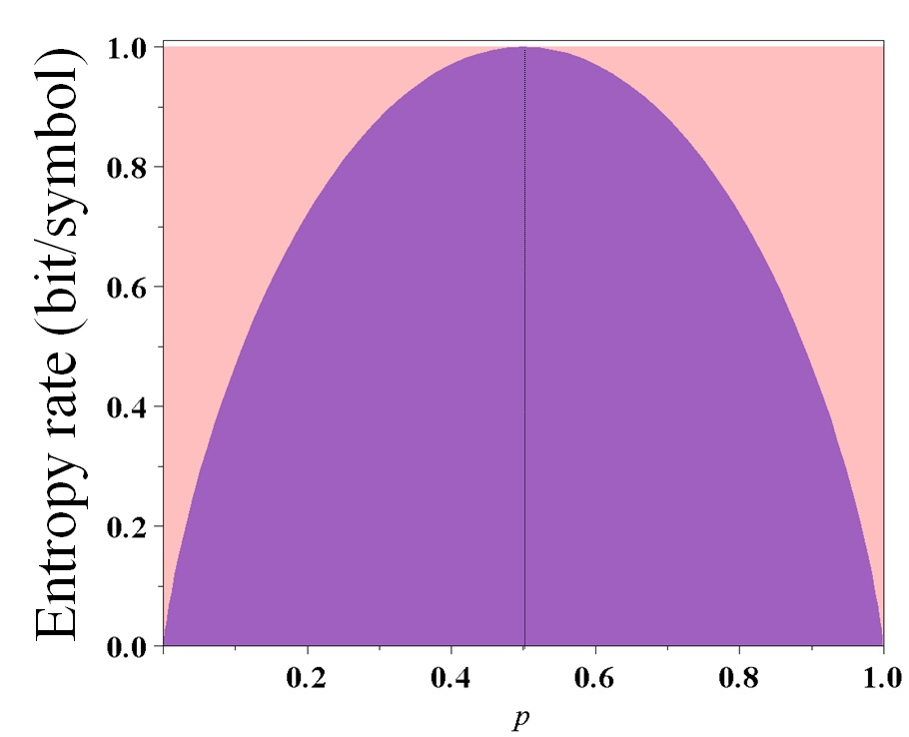
Tossing an unfair coin
$$H\left(X_{t}\right)−H\left(X_{t+1} | X_{t}\right)$$
$$E\left(p\right)=1+p\log{p}+\left(1−p\right)\log{(1−p)}$$
The excess entropy quantifies the component of information which is predictable from observing the history
$$E\left(p\right)$$
$$E\left(p\right)$$
The amount of information generated at each tossing, THE ENTROPY RATE
p = 0: ...0101010101...
p = 1: ...0000000 ..., ....111111...
p = 0

Slide 12
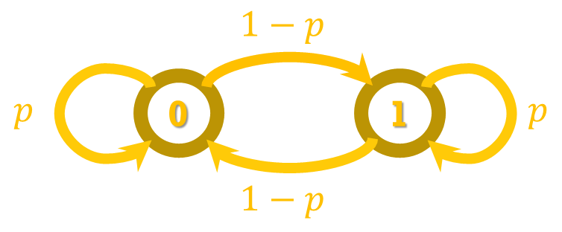
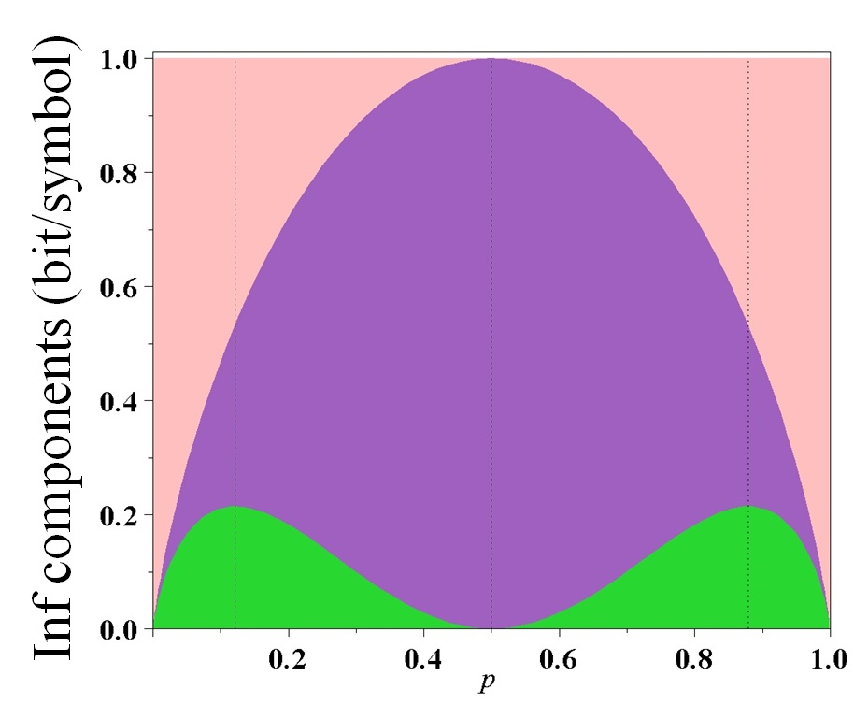
Tossing an unfair coin
$$\underset{I\left(X_{t};X_{t+1} | X_{t−1}\right)}{\underbrace{H\left(X_{t+1} | X_{t−1}\right)−H\left(X_{t} | X_{t−1}\right)}}$$
$$=p∙\log_{2} p +\left(1−p\right)∙\log_{2}\left(1−p\right)−2p\left(1−p\right)∙\log_{2} 2p\left(1−p\right)−\left(p^{2}+{\left(1−p\right)}^{2}\right)∙\log_{2}\left(p^{2}+{\left(1−p\right)}^{2}\right)$$
$$U$$
Information component existing only in the present moment, being neither a consequence of the past, nor of consequence for the future
The excess entropy quantifies the component of information which is predictable from observing the history
The influence of the present symbol on the forthcoming state of the chain
Unpredictable Information
...00101...
alternate the past symbol
...010100... repeat the past symbol
p = 0
p = 1
Destructive probabilistic interference => fairness

Slide 13
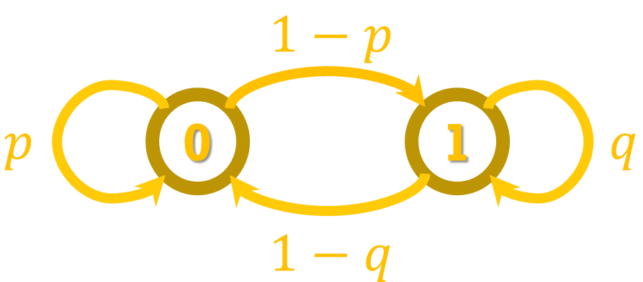
The entropy H (p, q) (transparent) and predictable information P (p, q)
The entropy H (p, q) (transparent) and
unpredictable information U (p, q)

Slide 14
Fractional coin tossing $(ε=1)$ is always fair!
As $ε→1$, transition steps $\sim [1,∞)$ , and the amount of predictable information about the future state vanishes, so that the coin flips as fair for any probability $p$.

Slide 15
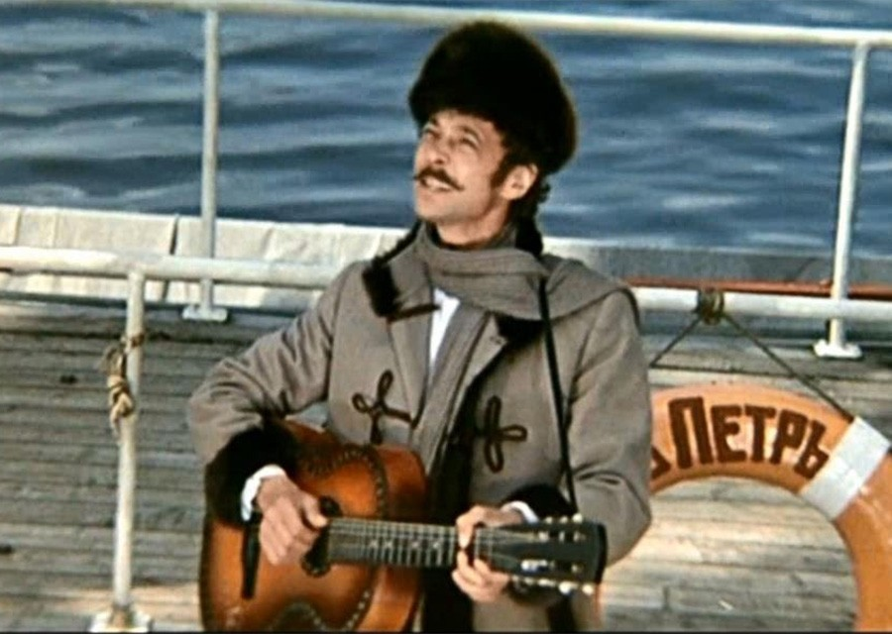
What did I learn due to Yuri’s question?
The vaguer “a blink of an eye when the future becomes the past”, the vaguer (less predictable) the future:
“What do we treasure // And what do we stand to lose // A blink of an eye // Just a blink of an eye … otherwise known as life”
“The Land of Sannikov”, a Soviet 1974 adventure movie
Blink of an Eye (Есть Только Миг)
(c) Mika Tubinshlak (Vancouver )
Volchenkov, D. Memories of the Future. Predictable and Unpredictable Information in Fractional Flipping a Biased Coin. Entropy 2019, 21, 807. https://doi.org/10.3390/e21080807

